Slide 1
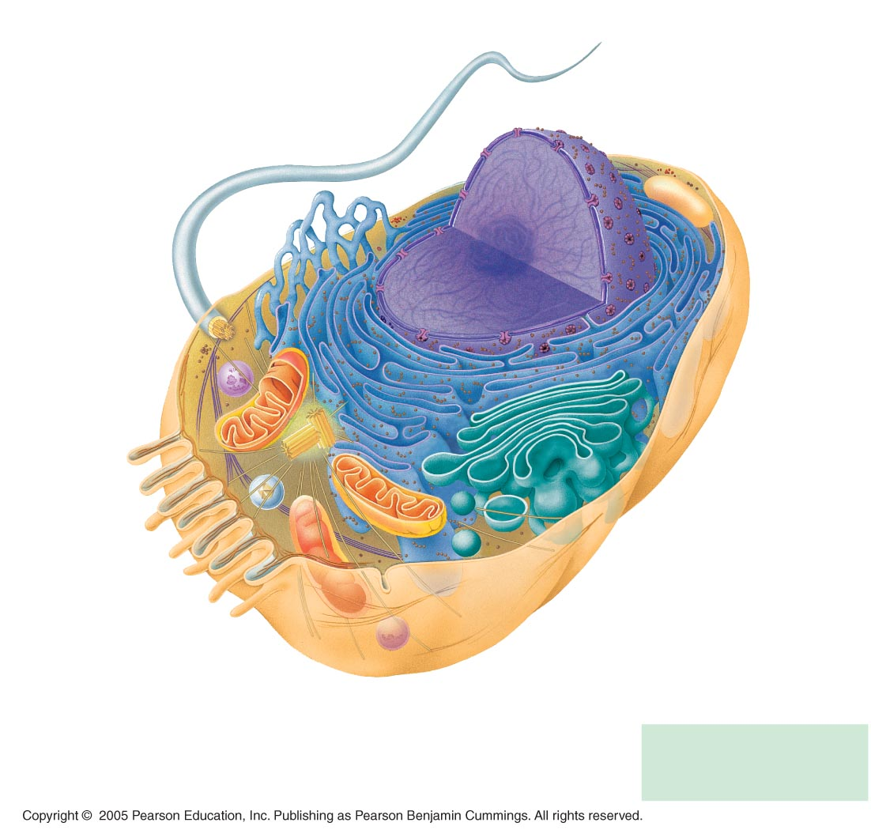
ENDOPLASMIC RETICULUM (ER
Nuclear envelope
Flagellum
Rough ER
Smooth ER
Nucleolus
NUCLEUS
Chromatin
Centrosome
Plasma membrane
CYTOSKELETON
Microfilaments
Intermediate filaments
Microtubules
Ribosomes:
Microvilli
Golgi apparatus
Peroxisome
Mitochondrion
Lysosome
In animal cells but not plant cells: Lysosomes
Centrioles
Flagella (in some plant sperm)

Slide 2
Centrifugation & Quantification
Cellular Structure
Centrifugation
Beer-Lambert Equation
Absorption Efficiency

Slide 3
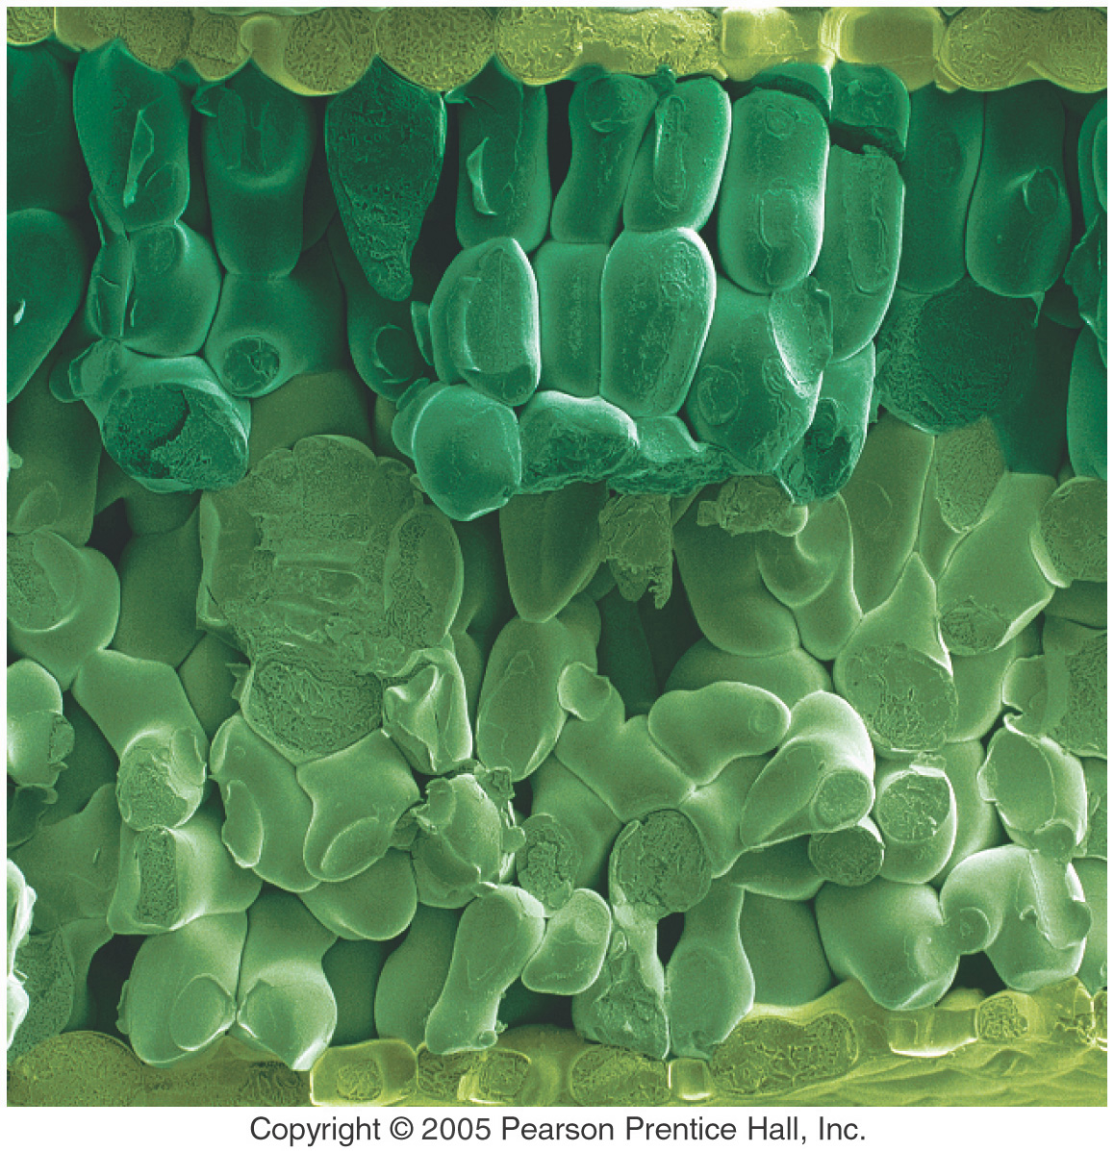
Cells In a Leaf

Slide 4
Energy-Related Organelles:
Mitochondria
Bounded by double membrane
  Cristae – Infoldings of inner membrane that encloses matrix
  Matrix – Inner semifluid containing respiratory enzymes
Involved in cellular respiration
Produce most of ATP utilized by the cell

Slide 5
Energy-Related Organelles:
Chloroplast
Bounded by double membrane
Inner membrane infolded
  Forms disc-like thylakoids, which are stacked to form grana
  Suspended in semi-fluid stroma
Green due to chlorophyll
  Green photosynthetic pigment
  Found ONLY in inner membranes of chloroplast

Slide 6
Captures light energy to drive cellular machinery
Photosynthesis
  Synthesizes carbohydrates from CO₂ & H₂O
  Makes own food using CO₂ as only carbon source
  Energy-poor compounds converted to enery rich compounds
Chloroplast structure includes:
  Thylakoids, membranous sacs, stacked to form a granum
  Stroma, the internal fluid

Slide 7
Purification of Cell Parts
Understanding the roles of each cell component depends on methods to break (lyse) cells and separate cell components for analysis
Cell lysis is accomplished by various techniques:
blender, sonication, tissue homogenizer, hypotonic solution
Separation of cell components generally involves centrifugation

Slide 8
Cell Fractionation
Cell fractionation takes cells apart and separates the major organelles from one another
Ultracentrifuges fractionate cells into their component parts
Cell fractionation enables scientists to determine the functions of organelles
Biochemistry and cytology help correlate cell function with structure

Slide 9
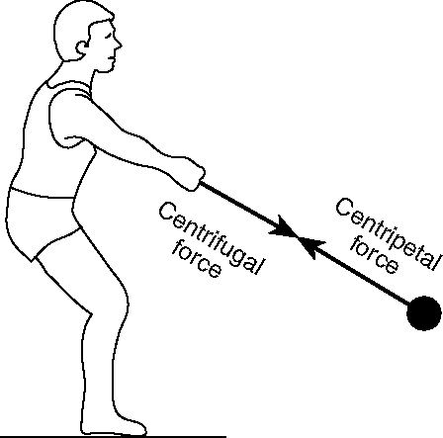
Forces Resulting from Spinning

Slide 10
Centrifugation
A centrifuge is used to separate particles or even macromolecules:
- Cells
- Sub-cellular components
- Proteins
- Nucleic acids
Basis of separation:
- Size
- Shape
- Density
Methodology:
- Utilizes density difference between the particles/macromolecules and the medium in which these are dispersed
- Dispersed systems are subjected to artificially induced gravitational fields

Slide 11
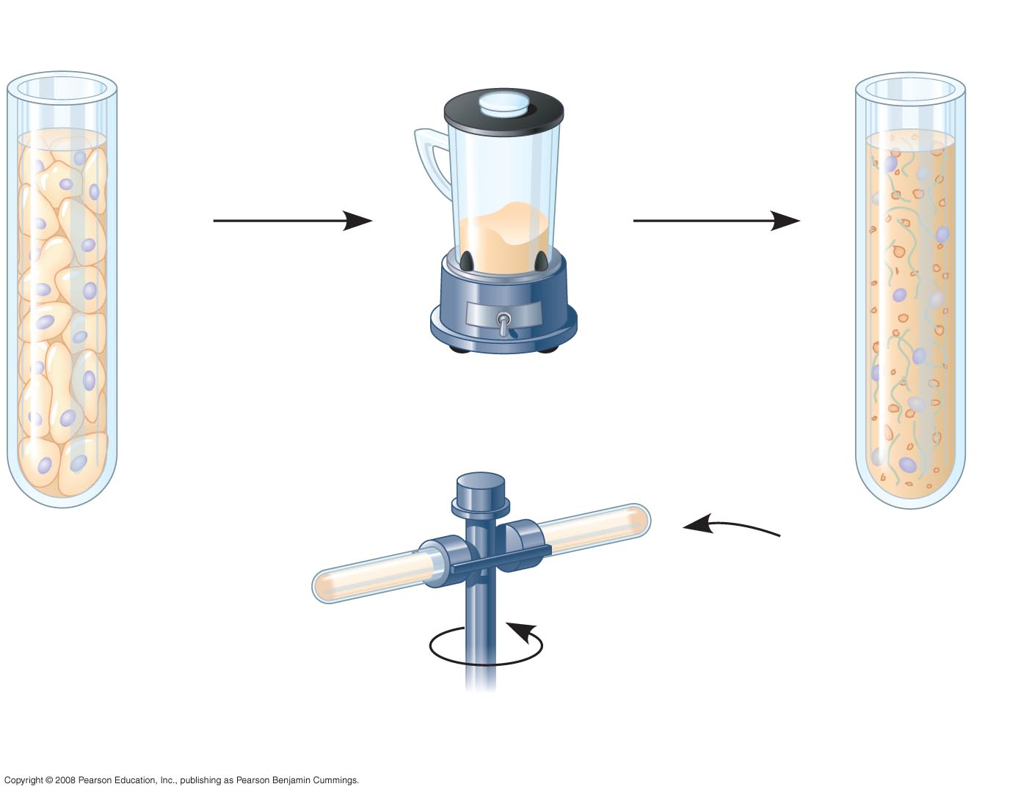
Homogenization
Tissue
cells
Homogenate
Differential centrifugation

Slide 12
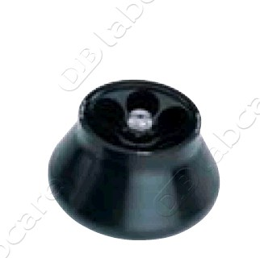
Fixed Angle

Slide 13
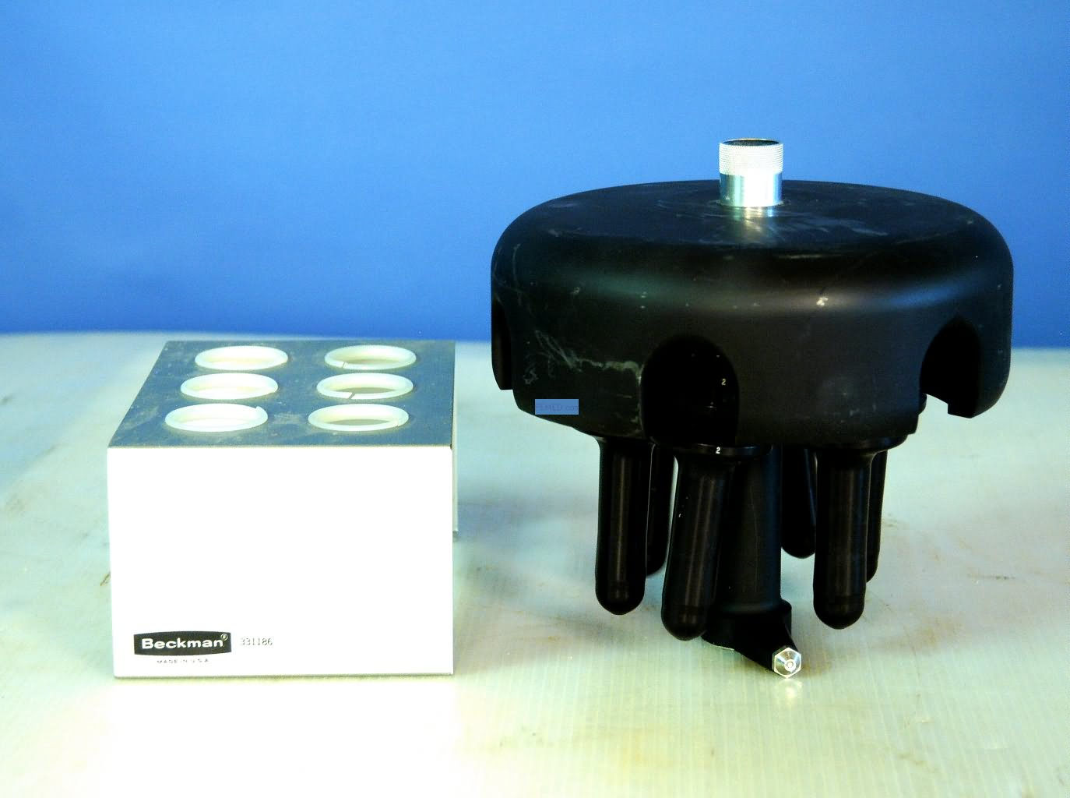
Swinging Arm

Slide 14
Centrifuge Rotors
axis of rotation
Swinging-bucket
At rest
Spinning
g
g
Fixed-angle
Notes:
There are two traditional types of rotor: swinging-bucket and fixed-angle
1 In the swinging-bucket rotor, at rest, the tube and bucket are vertical and the meniscus of the liquid is at 90° to the earth’s vertical centrifugal field.
2 During acceleration of the rotor the bucket, tube and meniscus reorient through 90° in the spinning rotor’s radial centrifugal field.
3 In the fixed-angle rotor only the meniscus is free to reorient – one of the reasons why open-topped tubes in particular must not be filled beyond the recommended level in a fixed-angle rotor, if spillage is to be avoided.

Slide 15
Geometry of Rotors
r_{max}
r_{av}
r_{min}
axis of rotation
a
r_{min}
r_{min}
r_{av}
r_{av}
r_{max}
r_{max}
b
c
Sedimentation path length
Notes:
The g-force or relative centrifugal force (RCF) in a rotor tube increases linearly with the radius, so the geometry of the tube with respect to the axis of rotation is important in determining the suitability of a rotor for a particular particle separation.
1 The rotor (or tube) of the swinging-bucket rotor (a) is routinely described by three parameters, the r_{min}, r_{av} and r_{max} (the distance from the axis of rotation to the top, midpoint and bottom of the tube) and the RCF at each point is described as g_{min}, g_{av} and g_{max}.
2 In a fixed angle rotor the value of r_{min}, r_{av} and r_{max} (and the corresponding RCFs) is modulated by the angle of the tube to the vertical; the difference between r_{min} and r_{max} being greater in a rotor whose tubes are held at a wide angle to the vertical (b) than in one with a narrow angle (c).
3 The sedimentation path length of the rotor (or tube) is r_{max} – r_{min}. For tubes of equal volume and dimensions, the sedimentation path length is longest for a swinging-bucket rotor and shortest for a narrow-angle fixed-angle rotor, although in Training File 2 rotors are described, which have even shorter sedimentation path lengths.

Slide 16
Stokes Equation
v = velocity of sedimentation
d = diameter of particle
ρ_{p} = density of particle
ρ_{l} = density of liquid
g = centrifugal force
μ = viscosity of liquid
Notes:
Different types of biological particle may be resolved on the basis of differences in their size and/or density.

Slide 17
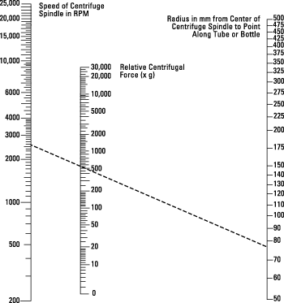
Use of a NOMOGRAM

Slide 18
Use in Lab
Microfuge | Low Speed | High Speed
15,000 rpm | 10,000 rpm | 30,000 rpm
21k x g | 8k x g | 100k x g
Separate precipitated DNA from supernatant, drive all liquid to the bottom of a tube | Separate solid pellet from liquid supernatant; pellet whole cells from liquid medium | Separate major components of cells from each other; separate mitochondria, nuclei, each

Slide 19
Types of Centrifugation
Differential Centrifugation: Rate-Zonal Centrifugation
Isopycnic Centrifugation: Density Equilibrium Centrifugation

Slide 20
Differential Centrifugation
This is the most common method of fractionating cells
Fractionation is the separation of the different organelles within the cell

Slide 21
Differential Centrifugation
Density of liquid is uniform
Density of liquid << Density of particles
Viscosity of the liquid is low
Consequence:
Rate of particle sedimentation depends mainly on its size and the applied G-force.
Notes:
Differential centrifugation is the simplest of the techniques used to resolve different types of biological particle and it is best illustrated by considering how it is applied to the partial purification of organelles from a tissue homogenate.

Slide 22
Size of Major Cell Organelles
Nucleus 4-12 μm
Plasma membrane sheets 3-20 μm
Golgi tubules 1-2 μm
Mitochondria 0.4-2.5 μm
Lysosomes/peroxisomes 0.4-0.8 μm
Microsomal vesicles 0.05-0.3μm
Notes:
The data in this graphic refers principally to the organelles from mammalian liver. Organelles from other tissues and from cultured cells may show some significant differences in detail. Under normal homogenization conditions sheets of plasma membrane are only obtained from an intact tissue such as liver. The recovery of Golgi tubules in the homogenate is also more commonly associated with tissues rather than with cultured cells.

Slide 23
Differential Centrifugation of a Tissue Homogenate
Decant supernatant
1000g/10 min
etc.
3000g/10 min
Notes:
In subsequent rounds of centrifugation and decantation, the RCF or the RCF and the centrifugation time are increased in order to pellet smaller and smaller particles. Each pellet is resuspended in the homogenization medium for analysis.

Slide 24
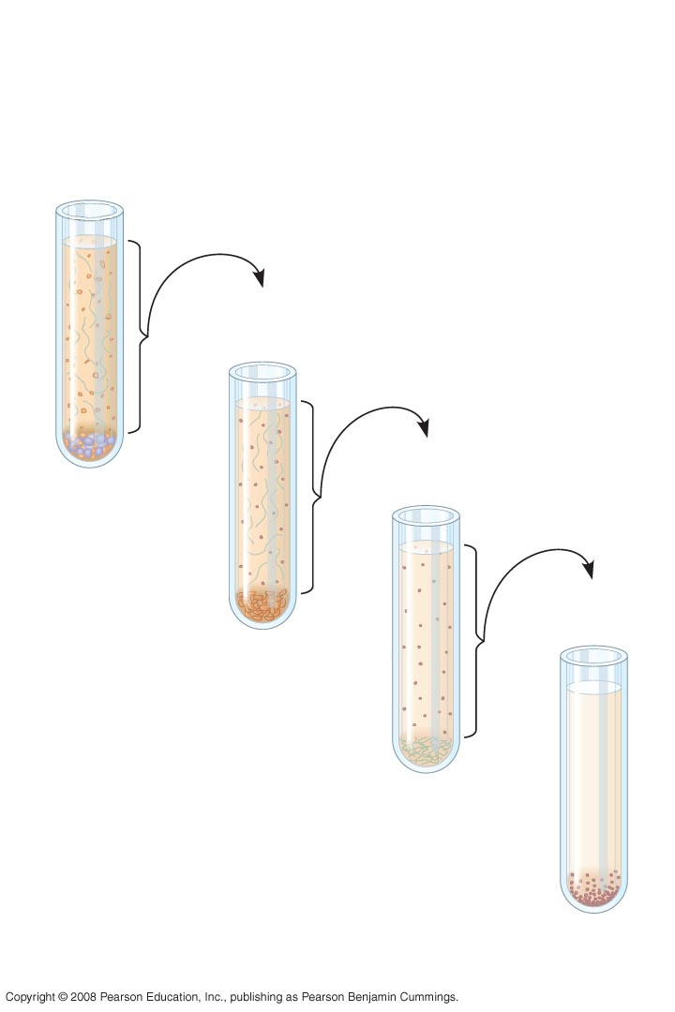
1,000 g
(1,000 times the force of gravity)
10 min
Supernatant poured into next tube
20,000 g
20 min
80,000 g
60 min
Pellet rich in nuclei and cellular debris
150,000 g
3 hr
Pellet rich in mitochondria (and chloro-plasts if cells
are from a plant)
Pellet rich in “microsomes” (pieces of plasma
membranes and cells’ internal membranes)
Pellet rich in ribosomes
Notes:
Figure 6.5 Cell fractionation, part 2

Slide 25
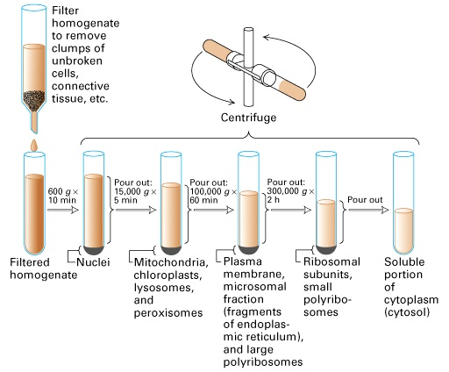
Cell Fractionation by Differential Centrifugation

Slide 26
Differential Centrifugation
Poor resolution and recovery because of:
  Particle size heterogeneity
  Particles starting out at r_{min} have furthest to travel but initially experience lowest RCF
  Smaller particles close to r_{max} have only a short distance to travel and experience the highest RCF
Notes:
Particles which, because of their starting position close to the meniscus, fail to pellet at a particular RCF and time, then contaminate the smaller particles in the next round of centrifugation. The problem of contamination of pellets by smaller particles, again by virtue of their starting position (close to the bottom of the tube) which should ideally remain in the supernatant, is also compounded by simple entrapment by the rapidly sedimenting larger particles. This can be overcome to some extent by resuspending the pellet in homogenization medium and repeating the centrifugation (so-called “washing the pellet”) two or three times. Repeated resuspension of the pellet however is tedious, time-consuming and may lead to further fragmentation of the particles. This procedure is however often used for the isolation of reasonably pure heavy mitochondria for oxidative phosphorylation studies.

Slide 27
Differential Centrifugation
Swinging-bucket rotor:
Long sedimentation path length
g_{max} >>> g_{min}
Fixed-angle rotor:
Shorter sedimentation path length, g_{max} > g_{min}
Notes:
The problem of poor recovery and resolution associated with the movement of particles through the suspending medium is less pronounced as the sedimentation path length of the rotor is reduced. Low-angle fixed-angle rotors will therefore provide better separations than swinging-bucket rotors. The downside of using low-angle fixed-angle rotors is that the pellets are less compact. Because the centrifugal field is radial, only in swinging-bucket rotors is the pellet located at the bottom of the tube; as the tube angle gets less so the pellet gets displaced further up the wall of the tube.

Slide 28
Density Gradient Centrifugation
Density Barrier
Discontinuous
Continuous
Notes:
To improve the resolution of particles in an homogenate, the various differential centrifugation fractions may be further fractionated in a density gradient. There are three basic formats: (i) a density barrier comprises just two layers, one of which is the sample; (ii) discontinuous gradients usually comprise 3-5 layers of different density, but can be as many 12 and (iii) continuous gradients in which the density increases smoothly (but not necessarily in a linear fashion) from top to bottom rather than step-wise as in (i) and (ii). Techniques for making gradients are presented in Training File 2.

Slide 29
How Does a Gradient Separate Different Particles?
Least dense
Most dense
Notes:
In this hypothetical situation, a mixture of three particles is placed on top of a continuous density gradient. The red and green particle are approximately the same size and much larger than the densest magenta particles.

Slide 30
Stokes Equation
When ρ_{p} > ρ_{l} : v is +ve
When ρ_{p} = ρ_{l} : v is 0
When ρ_{p} < ρ_{l} : v is –ve
Notes:
So long as ρ_{p}>>ρ_{l} then the particle will move down through the gradient at a rate determined mainly by d. All particles as they move through the gradient will be retarded by the increasing viscosity (μ) but accelerated by the increasing g-force. As the particle approaches that part of the gradient whose density is the same as its own density then ρ_{p} - ρ_{l} will approach zero and the particle will slow down and finally stop moving.

Slide 31
Buoyant density banding
Equilibrium density banding
Isopycnic banding
1
2
3
4
5
Notes:
Returning to our hypothetical situation.
All three types of particle start off sedimenting at a rate approximately proportional to their size. The low density red particles soon start to slow down as ρ_{p} approaches ρ_{l} and then stop when ρ_{p} = ρ_{l}. Later the green particles also slow down and stop at a higher density. The magenta particles being much smaller take a much longer time to reach their final banding position; this is called buoyant density, equilibrium density or isopycnic banding.
The problem for the magenta particles is that they have to travel through the banded red and green particles which may cause loss of resolution. In this respect, it may be advantageous to stop the centrifugation at stage 3, when there is separation of the three types of particle but the small magenta ones have not interacted with the banded larger ones. This is not an equilibrium position however, the magenta particles are separated on the basis of their sedimentation velocity and the centrifugation time is therefore critical.
The final equilibrium position is not dependent on the radial thickness of the sample layer, so long as all the particles are given sufficient time to reach their banding density. The Stage 3 position is dependent on the radial thickness of the sample layer, since neither the magenta nor green particles have reached an equilibrium position.

Slide 32
3 Formats for Separation of Particles According to Density
1
2
3
When density of particle < density of liquid V is -ve
Notes:
Equilibrium density banding can be achieved using different sample loading formats. Three particles are considered red, green and magenta, whose density increasers in that order. The magenta particles are however much smaller than the other two particles.
Format 1 is the familiar one in which the sample is layered on top of the gradient and all of the particles sediment to their buoyant density. In Format 2 the sample is placed in a dense medium beneath the gradient and all of the particles float to their banding position. The time taken for particles to reach their banding density is dependent mainly on their size. In Format 2 the small dense magenta particles only have a short distance to move – all particles will reach banding density more quickly in Format 2.
In Format 3 the particles are randomly distributed in the gradient (i.e. they are suspended in the solutions from which the gradient is made), particles will either sediment or float to their banding density. The lack of an interface between the sample and the gradient in Format 3 also avoids any transient build-up of particles which can occur in Formats 1 or 2 when the particles move from the sample zone into the gradient.

Slide 33
Resolution of Density Gradients
Density Barrier
Discontinuous
Continuous
I
II
Notes:
Density barriers or discontinuous gradients, because of their very nature, tend to produce sharp bands of material at interfaces or at the meniscus or as a pellet, but continuous gradients are likely to provide the highest resolution, even though the bands will be broader (due to particle heterogeneity) and harvesting of the banded material may be less easy (see Training File 2). Density barriers can be used to isolate the least dense particle (I) or the most dense particle as a pellet (II).

Slide 34
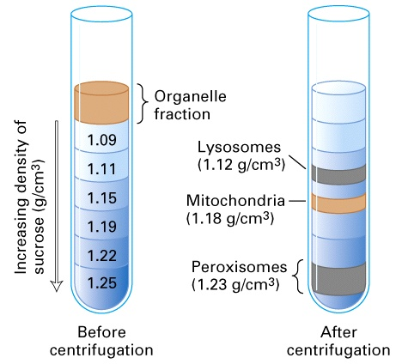
Organelle Separation by Isopycnic Centrifugation

Slide 35
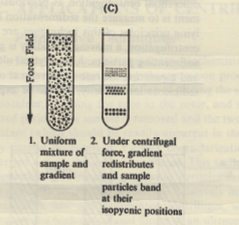
Isopycnic Centrifugation
The density gradient is formed
during the centrifugation.
The sample is dissolved in solution
of dense salt (e.g., CsCl, Cs2(SO4))
The macromolecules of the biological
sample seek an area in the tube
where the density is equal to their
respective densities

Slide 36
Densities of Biological Material
Material | Density (g/cm³)
Microbial cells | 1.05 - 1.15
Mammalian cells | 1.04 - 1.10
Organelles | 1.10 - 1.60
Proteins | 1.30
DNA | 1.70
RNA | 2.00

Slide 37
Separation of Particles According to Size
ρ_{p} >> ρ_{l} : v is +ve for all particles throughout the gradient
Notes:
Separation of particles purely on the basis of size, is very little encountered in subcellular membrane fractionation, but it is the only way of fractionating particles of identical or very similar density, such as proteins of different molecular mass and ribosomal subunits. The absolute requirement is a linear gradient whose density never approaches that of the particles, so that ρ_{p} - ρ_{l} never becomes rate-limiting. This is relatively easy only for particles such as proteins or ribonucleoproteins which have such high densities. A 5-20% sucrose gradient is often used for protein fractionation and this gradient is more or less isokinetic. In an isokinetic gradient, the forces which tend to decelerate the sedimentation velocity of the protein molecules (the increasing viscosity and decreasing ρ_{p} - ρ_{l} factor) and the increasing RCF which accelerates the molecules are balanced out, so that the molecules move at approximately the same velocity through the gradient – ideal conditions for sedimentation velocity separations. This condition is almost impossible to achieve for organelles which have different sizes and densities.
To maintain high resolution the sample size must be small (<8%) of the gradient volume, since the radial thickness of each zone of particles depends on the radial thickness of the sample. The density of the sample zone is often low so that the particles rapidly form a narrow zone on top of the gradient (zone sharpening).

Slide 38
SAFETY during Centrifugation
A rotor spinning at high speed is DANGEROUS
Always balance the tubes, to avoid damaging the centrifuge or yourself.
Never open a centrifuge that is spinning
Centrifuges generate aerosols

Slide 39
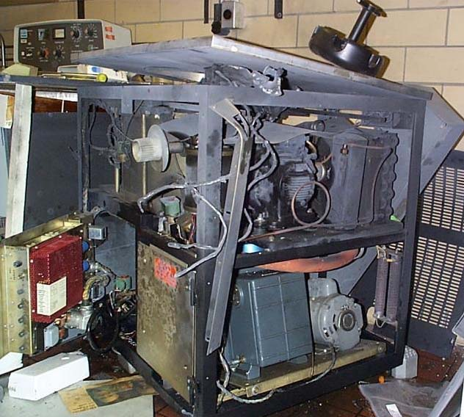
SAFETY

Slide 40
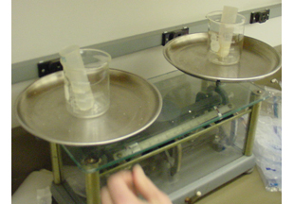
Balance your Tubes, Always!!

Slide 41
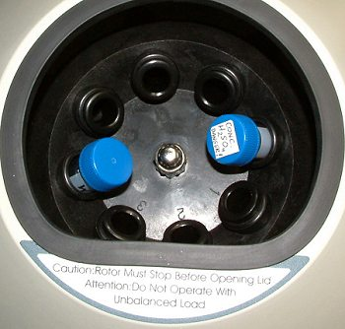
Load Tubes Evenly

Slide 42

Organelle Separation Procedure
Cut tissue in an ice-cold isotonic buffer. It is cold to stop enzyme reactions, isotonic to stop osmosis and a buffer to stop pH changes.
Grind tissue in a blender to break open cells.
Filter to remove insoluble tissue

Slide 43
Quantitation of Concentration
UV/vis Absorption
Limitation of Beer-Lambert Equation
Correct Choice of Wavelength
Spec 20

Slide 44
Beer’s Law
slit
cuvette
source
detector
A = -logT = log(P₀/P) = εcL
T = P_{solution}/P_{solvent} = P/P₀
Works for monochromatic light
Compound x has a unique ε at different wavelengths

Slide 45
Color of the sample
Remember:
  Solution absorbs red appears blue-green
  Solution absorbs blue-green appears red

Slide 46
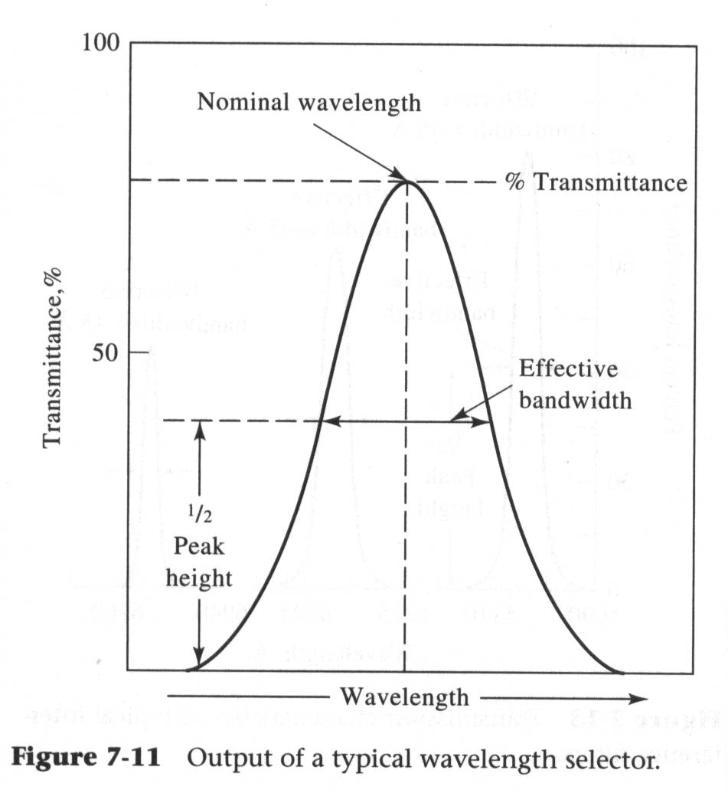

Slide 47
Types of Electronic Transition
Three types
  Involving π, σ, and n electrons
  Involving d and f orbital electrons
  Charge transfer electrons

Slide 48
Beer’s Law Analysis
Choice of wavelength
  Typically choose wavelength of maximum absorbance
  May deviate from this to avoid an interference

Slide 49
Different Shapes and Sizes of Cells

Slide 50
Cuvette
The cuvettes for use in the Spec 20 resemble small test tubes.
  Each cuvette is marked so that it can be positioned properly in the sample holder.
  The mark is at the top of the cuvette and must be positioned toward the front of the spectrophotometer when taking measurements.
  Handle these tubes with extreme care to keep both the inside and outside surfaces clean and free of scratches.
Cleaning the Cuvette:
  NEVER use a brush to clean the inside of the cuvette.
  Rinse the tube with distilled water a few times
  Add about 1 mL of the solution to be measured. Tilt and turn the cuvette so that the solution has contact with all the surfaces. Discard this solution and repeat this rinse once more.
  Fill the cuvette about 3/4 full of the solution you wish to test.
  Wipe the outside of the cuvette with a lint-free, soft tissue (a Chemwipe) to remove any moisture or fingerprints from the outside surface.

Slide 51
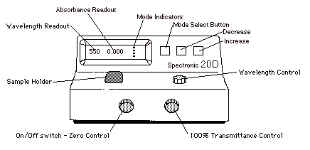
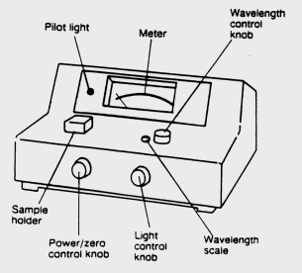
Spectronic 20
W filament light source
Grating dispersion
340 - 640 nm at 20±2.5 nm

Slide 52
Overview of Spectronic 20
Spectronic 20 is a spectrophotometer.
A spectrophotometer measures the intensity of a light beam before and after it passes through a sample and compares these two intensities.
The Spec 20 reports two types of measurements: percent transmittance (%T) and absorbance (A).
  Percent transmittance is the ratio of the intensity of the light passing through the sample to the intensity of the light shining on the sample multiplied by 100%.
  Absorbance is the log of the transmittance.
  The Spec 20 can measure absorbance and transmittance over a range of wavelengths.
You must select a wavelength and calibrate the instrument at that wavelength before making any measurements.

Slide 53
Generic Operating Instructions
Connect the Spectronic 20 to an electrical outlet.
  Turn on the instrument with the zero adjust/on-off control and allow about five minutes warm-up time.
  Turn the wavelength control knob to select the desired wavelength.
Calibration 0 %T
  With no sample tube in place and the cover closed, turn the zero adjust knob to bring the meter to 0% transmittance.
Calibration 100 %T
  Fill the spectrophotometer tube to about 2/3 with distilled water. Make sure that the outside of the tube is clean and dry (do not handle the tube on the sides so as to avoid fingerprints) and insert it in the cuvette holder, pushing it all the way down and aligning it so that the reference line on the cuvette holder matches a line (or other mark) on the tube. Close the cover of the cuvette holder.
  Adjust the light control knob on the spectrophotometer so that the meter reads 100% transmittance.
calibration should be repeated before each absorbance measurement.

Slide 54
Measuring the Sample
Fill (to 2/3) a tube with the solution to be determined.
  Wipe the outside of the tube to remove water and fingerprints and insert into the cuvette holder, aligning as above. Close the cover and read the % transmittance (or absorbance) from the meter scale.
The same sample tube should be used for all absorbance measurements.
  Care must be taken to align the tube in exactly the same way each time.
  A separate tube may be used for the distilled water blank, but again always align it in the same way.
Because the sample may be heated in the light beam or photochemical decomposition may occur,
  the absorbance reading should be made quickly after the tube is inserted.
It is good practice to read and record the % transmittance meter reading and to convert to absorbance later.
  The transmittance scale is linear and thus less subject to reading error than the logarithmic scale.

Slide 55
Calibrating the Spectronic 20
Plug in and turn on the Spec 20. It must warm up for 30 minutes before use. A schematic of an older instrument is shown at the left.
Set the instrument to the proper wavelength by turning the knob located on the right hand surface of the spectrophotometer. The wavelength setting can be seen through the window next to the knob.
Obtain a properly cleaned cuvette and fill it about 3/4 full of the reference solution (usually water).
With no cuvette in the sample holder, close the cover and rotate the zero light control knob (left front knob) to display a reading of 0.0% transmittance. Provided that the instrument is not turned off and this knob is not moved, no other adjustments to this control are needed.
Place the reference solution cuvette in the sample holder, close the cover, and rotate the light control knob (front right knob) to display a reading of 100.0% transmittance. This procedure must be repeated every time measurements are taken at a new wavelength or if several measurements are made at the same wavelength.

Slide 56
Requirement for Report
Tabulate all the absorbance of each tube measured.
Tabulate all the concentration of chlorophyll in each tube.
Graph the relationship between absorbance and tube number
Graph the concentration vs. tube number.
Attention: The unit of concentration.

